Slide 1



POTS REPLACEMENT
POTS IN A BOX

Slide 2


About
MIX Networks
For over 20 years, MIX Networks® has delivered tailored communication solutions to businesses nationwide, with a boutique-style approach that ensures every client gets a solution built for their unique needs.

Slide 3


Why Choose MIX?
Tailored Service: Unlike one-size-fits-all providers, our tailored approach ensures that your communications infrastructure supports your specific goals.
Reliability: Our geo-redundant network architecture achieves 99.999% uptime, ensuring your communications are always available when you need them.
U.S. Based Expert Team: Our experienced telecommunications professionals are dedicated to delivering exceptional service and support​

Slide 4













Customer and Deployment Snapshot​
Assisted Living and Senior Care Facilities​
Healthcare Clinics
Local and State Government Agencies​
Retail Chains and Property Management Firms​
Educational Institutions​

Slide 5

Deployment Capabilities – What Sets Us Apart
Skilled In-House Technicians: Our team of telecom experts handles new site installations with precision and professionalism.
Nationwide Coverage: A trusted network of field technicians ensures reliable support across the U.S. for service calls and maintenance.
Responsive U.S.-Based Support: Quick access to knowledgeable tech support via phone or email—no long hold times.
Flexible Hardware Solutions: A wide range of hardware options designed to meet diverse operational requirements.

Slide 6

Why is
POTS IN A BOX Important
Business Impacts:
1
Increasing Cost of POTS Lines
Reduced PSTN Availability and Support
2
Complex Billing—Multiple Carriers All at Different Rates
FCC Forbearance
FCC Forbearance was passed August 2nd, 2019. DataRemote POTS IN A BOX® Is currently the closest to a real POTS line, PSTN-replacement device.
3
Stranded Legacy Assets—Equipment With Analog Interfaces
4

Slide 7
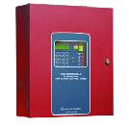
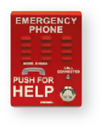
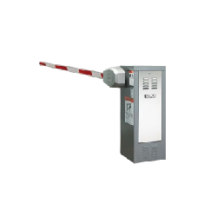
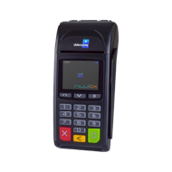

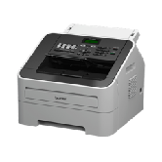
POTS REPLACEMENT
Supports PSTN (POTS) lines for specialty line signaling such as transmission of FAX, modem, fire & burglar alarm, analog data, ring-down, POS, ATM, Key Systems, voice and more!
FIRE PANEL
EMERGENCY PHONE
POS
GATE & DOOR ACCESS
ELEVATOR
FAX

Slide 8
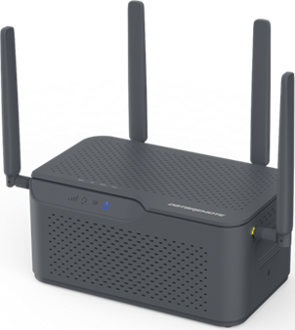





One Device Enables Multiple Offers
OTT Voice & PSTN Specialty Lines
Battery Backup & UPS
Broadband
5G Broadband

Slide 9


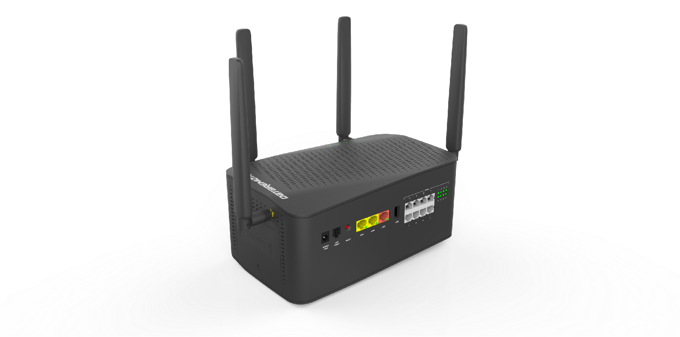






90X1
Voice Lines
VoIP module certified for RingCentral, MetTel, Velocity, and AT&T C-VoIP & B-VoIP
24-48 HR battery
Very large (18-cell) lithium battery for extended operation without A/C power
Enhanced Lines
DataRemote proprietary analog POTS replacement technology
Cellular Internet Back-Up
5G Cellular failover for resilient internet connectivity
UPS Backup
Provides power from battery to external device (cordless phone, internet gateway, etc)
Device Management Portal
Advanced ACS2.0 device management user interface and API for system integration
Location Services
GNSS and cellular triangulation to provide advanced location services
Full In-House Development
All software developed locally in-house for improved agility and product quality

Slide 10
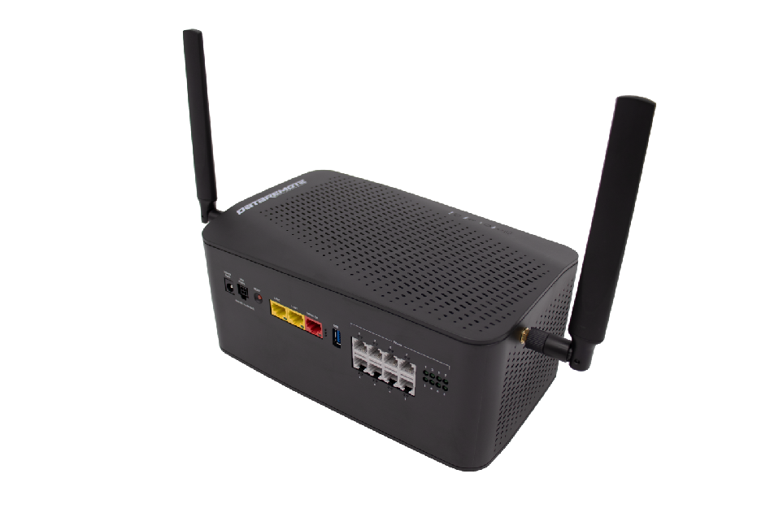
90X2
Voice Lines
VoIP module certified for RingCentral, MetTel, Velocity, and AT&T C-VoIP & B-VoIP
24-48 HR battery
Very large (18-cell) lithium battery for extended operation without A/C power
Enhanced Lines
DataRemote proprietary analog POTS replacement technology
Cellular Internet Back-Up
4G Cellular failover for resilient internet connectivity
UPS Backup
Provides power from battery to external device (cordless phone, internet gateway, etc)
Device Management Portal
Advanced ACS2.0 device management user interface and API for system integration
Location Services
GNSS and cellular triangulation to provide advanced location services
Full In-House Development
All software developed locally in-house for improved agility and product quality

Slide 11


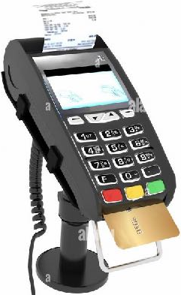
POS Terminal with 90X1 Backup
90X1 Use Case
Ethernet cable from Customer Broadband Router to 90X1 WAN to enable FXS ports and LAN
POS connected to 90X1 RJ-11 port
Failover to 5G when Broadband on WAN drops
90X1 FXS and LAN ports continue to function normally via 5G
Internet
AC Inverter powered by 90X1 for POS
90X1 provides un-interrupted battery backup for POS
Cellular Network
8 FXS jacks compatible with PSTN POTS

Slide 12



Retail Use Case:
National Fitness Center
Business Problem
Need to reduce cost and increase operational effectiveness
Need to protect against outages during emergencies and keep devices connected and operational .
Solution
AT&T Phone for business — Advanced keeps speciality appliances
Connected with full access to E911 with voice while transmitting
Voiceover IP without cost expense of replacing Analog equipment
Overview
Retail businesses are experiencing rising cost, low availability, and increased maintenance times for critical POTS lines such as Elevator, Fire Panels, and other critical infrastructure.
Customer Benefits
One provider, nationwide coverage
Service continuity with power (12 hr battery) and wireless internet backup to support compliance needs for disaster/emergency preparedness
Proactive notification of specialty line outage

Slide 13



Retail Use Case:
Assisted Living
Facility
Business Problem
Maintain life safety compliance to ensure uninterrupted service for emergency systems.
Stay within the budget constraints
Solution
UL 846 certified for fire alarm systems
Remote management & monitoring
Overview
There are over 30,000 assisted living communities across the United States, supporting nearly 1.2 million residents. These facilities rely heavily on legacy copper POTS lines to power critical systems such as fire and burglar alarms, elevator emergency phones, etc.
Cost-effective vs. legacy landlines
(Saved $50-$100+ per line/month)
Customer Benefits
Cut monthly telecom costs by 60%
Maintained full code compliance
Improved resiliency during power outage with LTE failover
Avoided costly upgrades to existing analog
infrastructure

Slide 14
THANK YOU!
MIXNETWORKS.COM

