Slide 1

Hosted Voice
Reliable • Scalable • Easy to Manage

Slide 2

Why Hosted Voice with MIX Networks?
Transform your communication infrastructure with enterprise-grade features delivered through the cloud.
Hosted voice provides a wide range of sophisticated features, including auto-attendants, call routing, call recording, and voicemail-to-email transcription. This helps streamline workflows and improves the customer experience.
Cloud-based offering Enhanced collaboration
Business continuity built-in
Mobility: desktop, mobile app, softphone
Easy scalability: 1 to 1000+ users
Lower total cost of ownership
Port existing numbers
Customize your operations, call flow, and workflows
Emphasis on security

Slide 3


Management and Reporting
Gain complete visibility and control over your entire communications network.
Cloud-Based PBX Management – Control user end points, locations, and devices from anywhere through our PBX management software
Advanced Reporting – Call logs, call trace (SIP Logs, SIP ladder diagrams), missed calls, peak hours, employee activity
  Call handling: programable routing, transfer, forwarding, queues, hunt groups
  Auto attendants / IVR: menu structure, scheduled, personal
  Voicemail management & transcription
  Mobility: UCFone mobile app, hot desking
  Presence, intercom, paging
  Web portals for users & managers
  Custom music on hold and branding messages
  ACD and Call Queues with reporting
  API availability
  DID Management
  Silent monitoring, barge/whisper/listen
  Device provisioning & inventory management

Slide 4
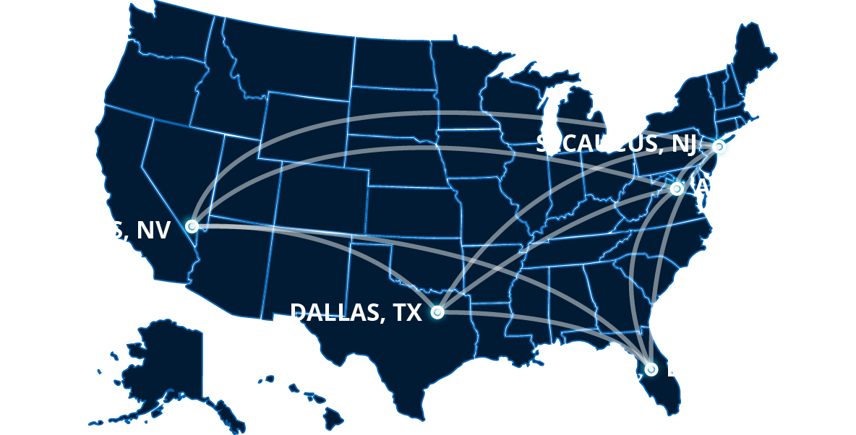
Reliability and Security
Industry-Leading Performance
99.999% uptime target
HIPAA-ready compliance
Active-active failover architecture
Geo-redundant servers (Ashburn, Dallas, Secaucus, Las Vegas)

Slide 5

Reliability and Security
Your business communications protected by enterprise-grade infrastructure.
Secure & Redundant – Cloud-based systems and servers are distributed across multiple data centers in the United States, eliminating single points of failure.
  All data is automatically replicated to every node in the network
  Every account has a primary and secondary PBX, these primary and secondary PBX’s will be geographically diverse to avoid single data center failure
  All supported devices use SRV failover and automatically switch back to primary, once primary is available again
  4G/5G Network Failover: When paired with our QoS router (such as a Peplink B One), deployments include automatic wireless failover for uninterrupted service.
  MIX Voice Assured: Our SD-WAN-powered solution delivered through our QoS router provides hot failover and prioritized voice traffic that maintains call quality during outages.
  Our system dynamically detects each device’s active registration (primary or secondary PBX) and routes inbound calls, accordingly, maintaining uninterrupted service.

Slide 6
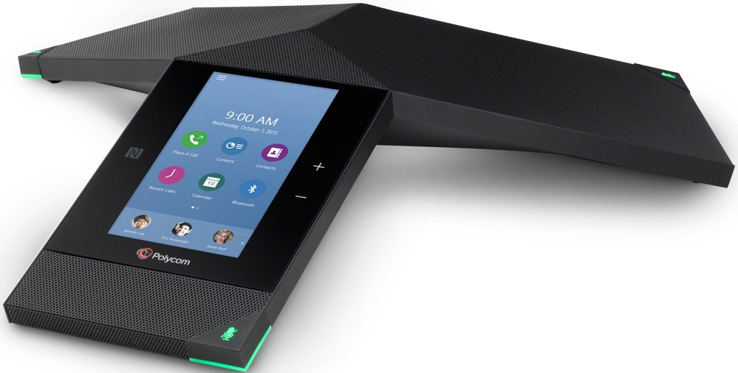
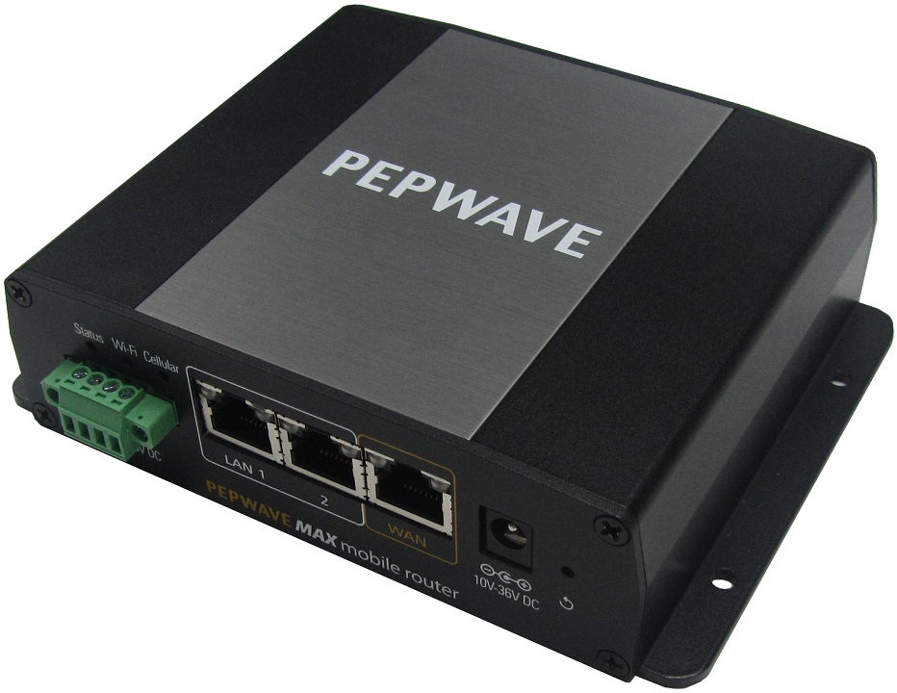
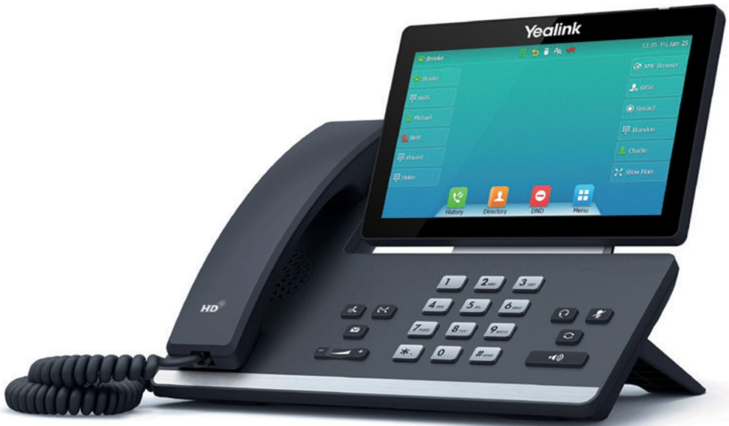
MIX Hosted Voice Equipment
Flexible hardware options that work with your existing infrastructure.
Wide Range of IP Equipment- Ranging from IP Phones (Yealink, Poly) to routers and gateways (DataRemote)
Support for analog endpoints such as paging and fax through ATAs (Pangea, Grandstream)
Full range of endpoint options for every use case

Slide 7
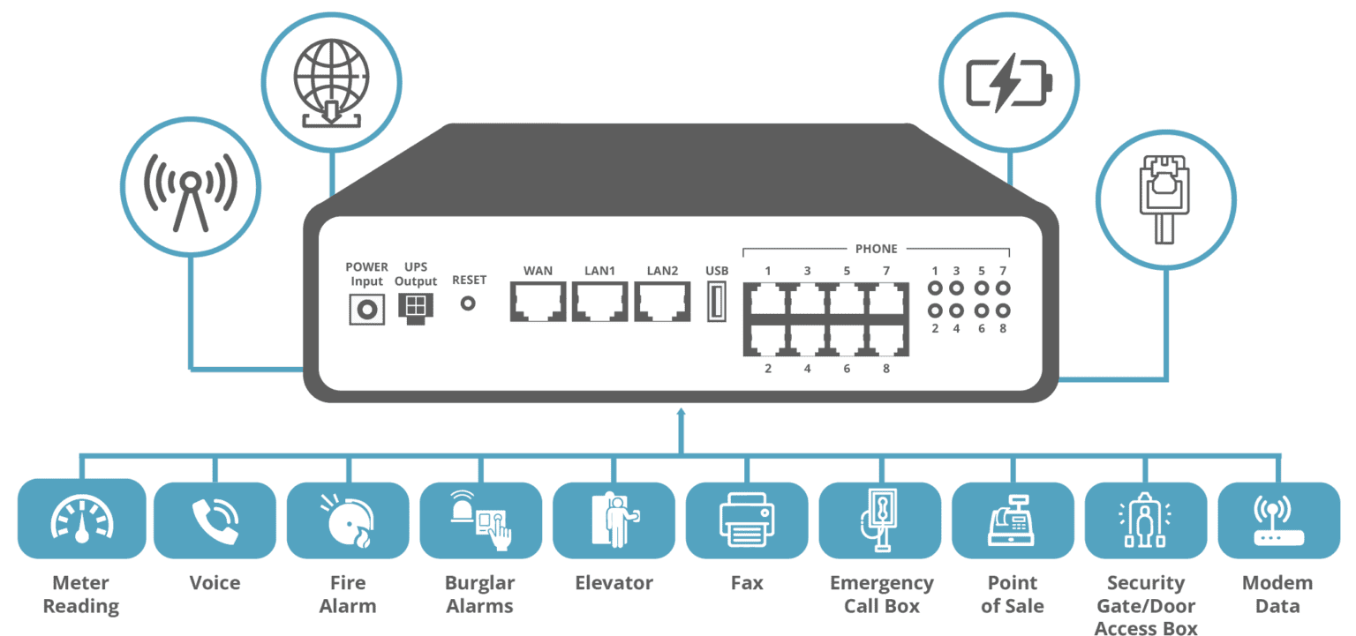
MIX Copper Line Replacement
Regulatory compliant hardware options that work with your existing infrastructure.
Legacy Device Support – Enables use of current legacy systems while adapting them to use pieces of hosted VoIP services
Protect your existing hardware investment
Seamlessly integrate current legacy systems
Gradual migration to hosted VoIP services
No forced forklift upgrades

Slide 8

Bridge the gap between Teams collaboration and enterprise telephony
MIX Networks® Teams Integration
Extended PBX Capabilities in Microsoft Teams
The MIX Solution:
Full PBX Power Inside Teams
Advanced Call Routing & Contact Centers
Full Fax Integration
Analog Device Support
Multiple Direct Routes for Redundancy
Seamless Desktop, Mobile, & Web Experience
Find Me / Follow Me
Ideal for:
Microsoft Power Users
Schools & Government
Mobile Workforces
Assisted Living
Enterprise
Key Benefits
& Highlights
Satin codec & noise suppression = crystal clear calls
Enhanced mobile integration vs. standard Teams calling
Works directly in Teams interface (no disruption to workflows)
Enterprise-grade reliability, cost-effective, future-proof

Slide 9

MIX handles logistics so resellers can scale faster and deliver professional-grade results.
MIX Networks® Installation Services
Nationwide, Professional Deployment — Done for You
Turnkey Installation for single sites or national rollouts
Hands-off experience for resellers and customers
Reduces technician overhead and truck rolls
Ensures correct installation the first time
Improves customer satisfaction and lowers support calls
Included
Services:
Nationwide field technician network
POTS replacement installations
Onsite surveys for complex locations
Cloud PBX line validation
Cellular hardware installs
White-label installation experience

Slide 10
Ready to transform your communications?
NEXT STEPS
Schedule a demo
Partner with MIX Networks as your Hosted Voice provider
Contact: sales@mixnetworks.com | 863-500-5000
MIXNETWORKS.COM

