Slide 1
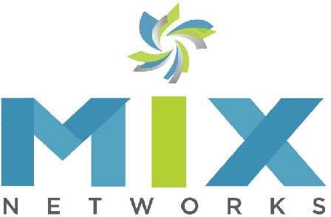
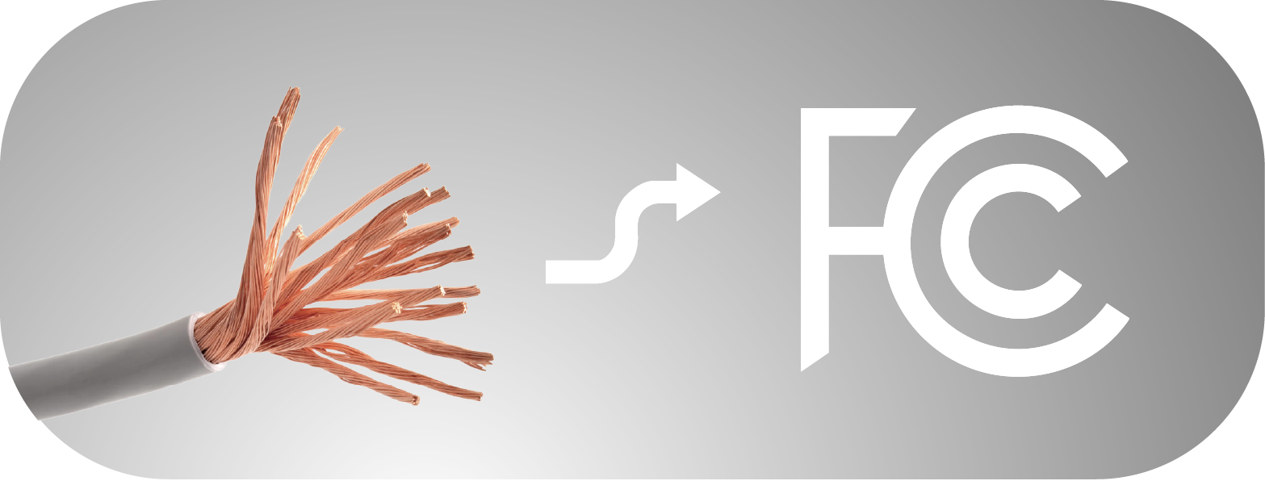
Copper line Transportation to
Digital Consideration
The Business Case for Upgrading Outdated POTS Lines

Slide 2
FCC Forbearance – PSTN Decommission
Why the time is now:
1
2
3
Regulatory Compliance
4
Operational Risks
5
FCC
Shutdown
Rising
Costs
Path Forward
“FCC grants relief from outdated and burdensome regulations governing Plain Old Telephone Service… Speeds transition to next generation networks”
Maintaining aging copper infrastructure is expensive
Legacy POTS lines often fail to meet the stringent requirements of modern regulations
Outdated copper lines provide limited data control and are vulnerable to breaches
As the world shifts to 5G carriers neglect legacy infrastructure

Slide 3



FCC Shutdown
FCC Mandates Are Accelerating the Shift to Modern Networks.
Customers and resellers of POTS line services must transition
to an alternative service.
This FCC Decision is accelerating the shift toward next-generation digital networks
What does this mean for you?
Businesses relying on POTS lines need to act now to avoid service disruptions as copper line support is phased out.
Why upgrade now?
FCC has accelerated the effort to shut down the PSTN
by easing the carrier requirements. FCC unanimously approves measure to speed transition from copper lines.
On August 2, 2019, FCC order 19-72A1 officially granted telecommunications carriers permission to abandon outdated, degrading copper POTS lines.

Slide 4

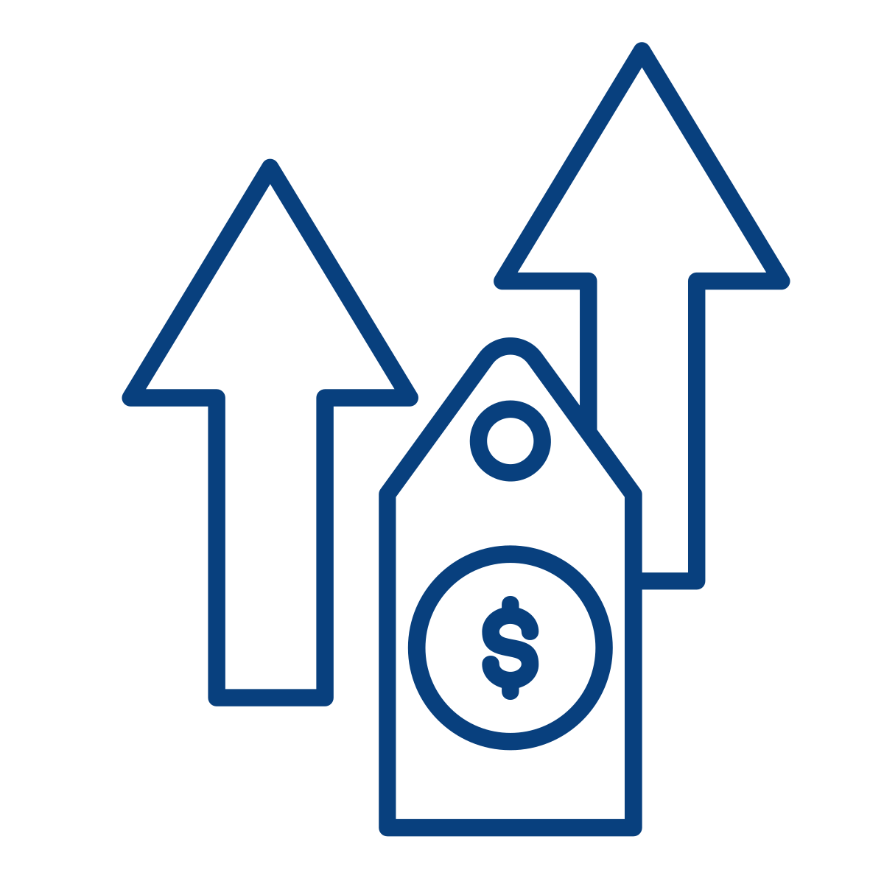

Rising Costs
Soaring Costs Make Legacy Infrastructure Unsustainable
Cost of Maintenance Maintaining outdated infrastructure is increasingly expensive as systems require frequent repairs. | Price Hikes POTS line rates have skyrocketed, with increases ranging from 100% to 1,000%, and costs continue to climb. | Financial Burden Businesses are paying more for less reliability, with outdated systems prone to failure.
Switching to digital communications not only reduces ongoing maintenance costs but also ensures more reliable service.

Slide 5


Regulatory Compliance
Modern regulations demand secure, compliant communications. Legacy POTS lines often fail to meet the stringent requirements in areas such as safety, payment processing, and data privacy.
Key Standards
Risk of Non-Compliance
Businesses today must adhere to standards like PCI for financial transactions, HIPAA for healthcare data, and NFPA for life safety.
Failing to meet these standards can lead to costly fines and reputational damage.
Transitioning to compliant digital platforms ensures you meet current regulatory requirements, reducing legal and financial risks.

Slide 6

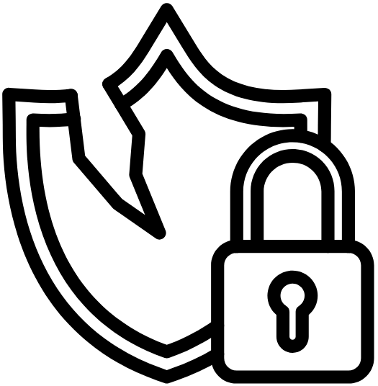
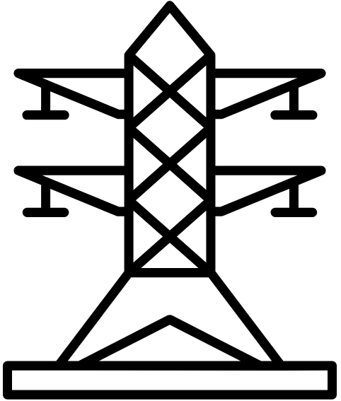

Operational Risks
Outdated POTS lines pose significant operational risks.
Vulnerability to Breaches
Copper lines provide limited control over data, making them vulnerable to security breaches and data loss.
Industry-Specific Risks
Industries like healthcare, finance, and government face particularly high stakes with aging, insecure infrastructure.
Upgrading to our robust,
secure digital solutions reduces
operational risks, offering businesses
greater control and reliability.
Limited Functionality
POTS lines lack the ability to support advanced communication features, putting businesses at a disadvantage.

Slide 7

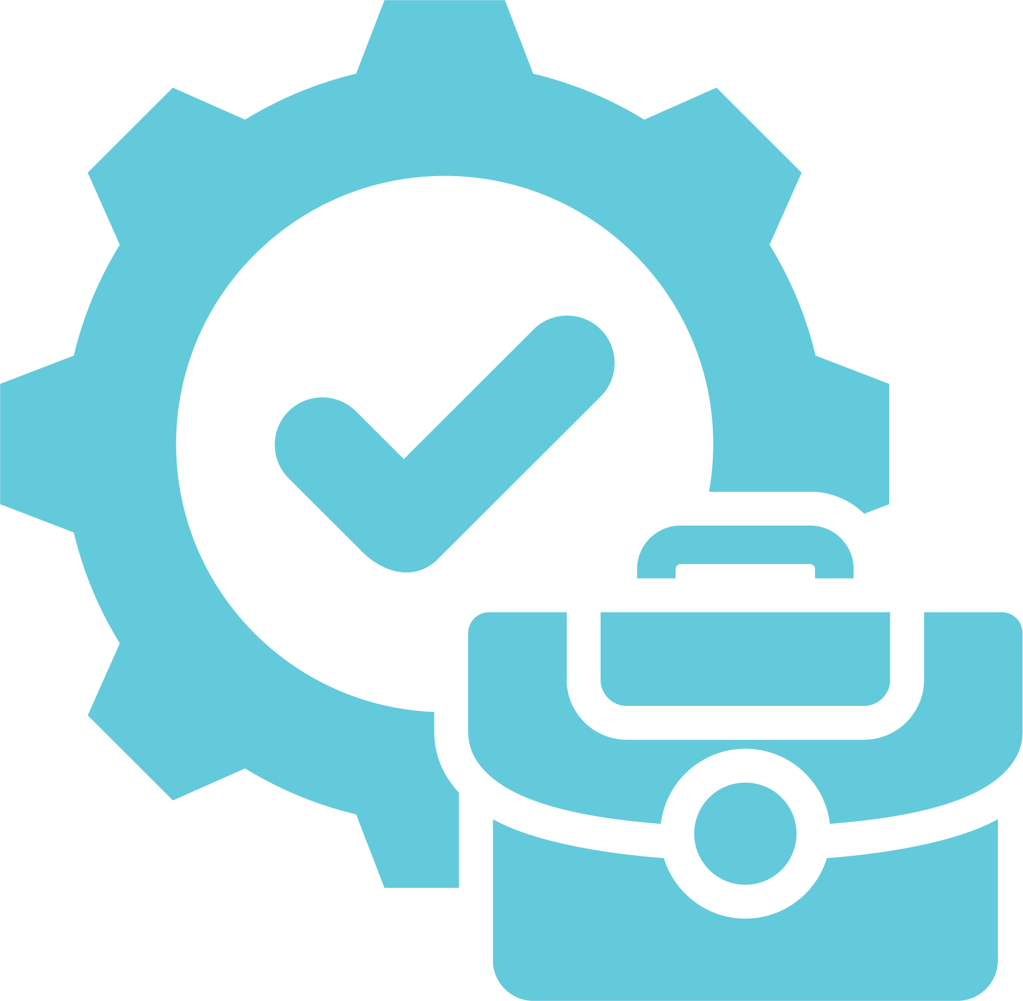

Smart Business Decisions
Real Results: Lower Costs, Minimize Disruptions, and Future-Proof Your Business
Lower Costs Fitness Chain Cuts $1.5M in Annual Expenses The national chain replaced outdated POTS lines with our VoIP solution reduced connectivity issues, enabling uninterrupted member management and payment processing. Annual savings exceeded $1.5M by eliminating service disruptions during peak hours. | Reliable Connectivity Coffee Chain Secures Consistent Service A nationwide coffee chain gained reliable connectivity by transitioning to VoIP, reducing interruptions in both new and renovated locations. Our solution provided compliance and continuity across all sites. | Future-Ready Technology Healthcare Provider Enhances Patient Safety Our VoIP solution replaced outdated POTS lines, ensuring compliance and reliability for critical medical equipment. The upgrade safeguarded patient care and operational efficiency. The router in our solution also supports additional applications, including 5G primary internet and backup.
Switching to digital communications not only reduces ongoing maintenance costs but also ensures more reliable service.

Slide 8


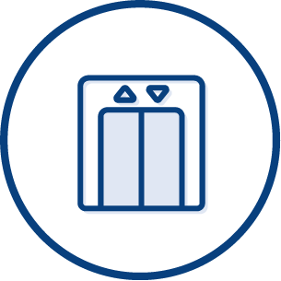

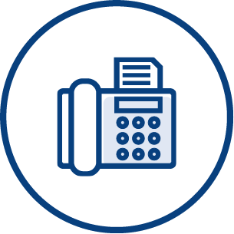
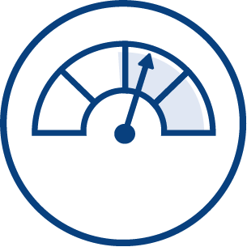
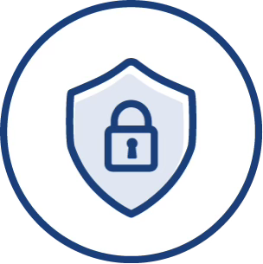



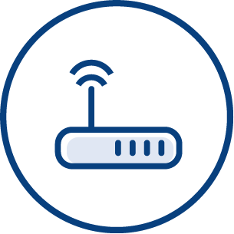

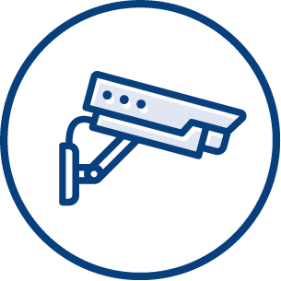
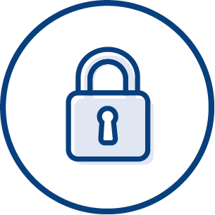
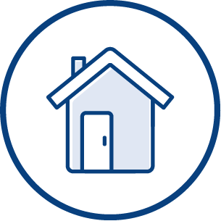

Applications that use POTS Lines
These legacy systems still use POTS:
SCADA Applications
Fire Alarms
Blue Light
Elevators
Security Gate Door Access
Internet Backup
FAX
Meter Reading
Out of Band Management
Panic Button
Modem
Pool Phone
Security Systems
Physical Security Services
Area Refuge
PA System

Slide 9








Industrial Verticals
Government Enterprise & SMB
Retail
Healthcare/
Pharmacies
Finance
Education Schools
& Campuses
Hospitality
Commercial
Real Estate
Oil/Gas
Manufacturing

Slide 10
THANK YOU!
MIXNETWORKS.COM

